Slide 1
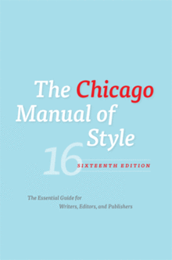
Citing
Writing 2101
Dr. Andrew Chater
Week 6

Slide 2
When To Cite
A quote
An idea that is not your own
A fact or figure you did not gather
Facts that are not obvious
For example, “More than 75 million people died during the Second World War” requires a citation.
CITATIONS
When you draw on a source in most university writing, you need to include an in-text citation that shows where the information comes from, and include a list of all of the utilized sources at the end of the paper in a proper bibliographic format
Why should you cite?

Slide 3
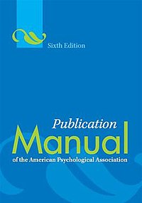
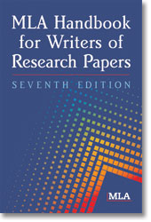
When Not To Cite
Famous quotes
Your own opinion or ideas
Facts or figures you gathered or created
Facts that are common knowledge
For example, “The Second World War began in 1939” does not require a citation.
How do you know what is common knowledge?

Slide 4
APA vs. CMS vs. MLA
 | APA | CMS | MLA
Disciplines | Psychology, sociology, sciences | History, political science, social sciences | English, languages, humanities
Citations in text | In-line | In-line OR footnotes OR endnotes | In-line
Citations list | References Include a list of all works cited in the paper Place in alphabetical order | Bibliography Include a list of all works cited in the paper PLUS any key works read but not cited in research process Place in alphabetical order | Works Cited Include a list of all works cited in the paper Place in alphabetical order

Slide 5

Citations In A Bibliography
Journal Article
Bloom, Evan T. “Establishment of the Arctic Council.” The American Journal of International Law 93, no. 3 (1999): 712-722.
Graham, Erin R. “International Organizations as Collective Agents: Fragmentation and the Limits of Principle Control at the World Health Organization.” European Journal of International Relations 20, no. 2 (2014): 366-390.

Slide 6
Citations In A Bibliography
Book
English, John. Ice and Water: Politics, Peoples and the Arctic Council. Toronto, Ontario: Allen Lane, 2013.
Landriault, Mathieu et al. Governing Complexity in the Arctic Region. Abingdon, Oxon: Routledge, 2020.
Chapter in a book
Apeldoorn, Bastiaan, Henk Overbeek and Magnus Ryner. “Theories of European Integration: A Critique.” In A Ruined Fortress?: Neoliberal Hegemony and Transformation in Europe, edited by Alan W. Cafruny and Magnus Ryner, 17-46. Oxford: Rowan and Littlefield, 2003.

Slide 7
Citations In A Bibliography
News article
Associated Press. “Arctic Council Grants China, Japan Observer Status.” May 15, 2013. http://www.cbc.ca/news/canada/north/arctic-council-grants-china-japan-observer-status-1.1375121 (accessed November 10, 2014).
Gricius, Gabriella. “Why Freezing the Arctic Council is Bad News for Global Security.” The Conversation, April 20, 2022. https://theconversation.com/why-freezing-the-arctic-council-is-bad-news-for-global-security-181467 (accessed May 3, 2022).

Slide 8
In-Line Citations
Include the authors’ name and the page where the reader can find the information after sentences drawing from outside sources.
Example:
The Arctic Council is the only international institution that includes indigenous peoples’ organizations as members (Chater, 2015: 231).
It is acceptable to provide one citation if several sentences in a row cite the same page in the same work.
Each point must be cited separately if each citation draws from a different page.

Slide 9
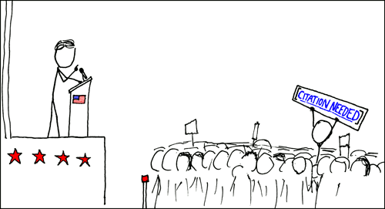
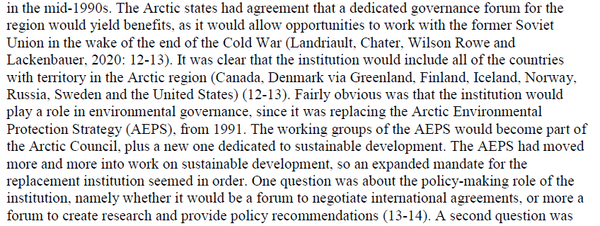
In-Line Citations

Slide 10

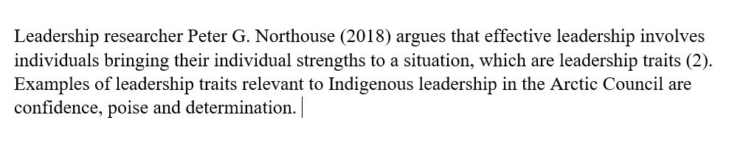
In-Line Citations

Slide 11
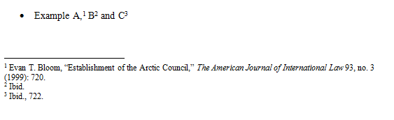
Footnotes
Another option for in-text citing is footnotes.
These can also appear as endnotes.

Slide 12
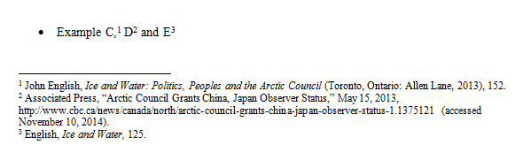
Footnotes
Do not include both footnotes and in-line citations.

Slide 13
Quotations
Introduce quotes (In the words of Waltz, “ . . . “)
Avoid long quotes (paraphrase!)
Avoid offset quotes (quotes that are longer than 3 lines)

Slide 14
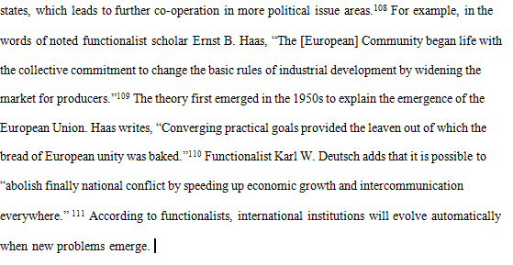
Quotations

Slide 15
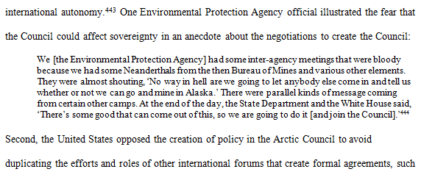
Quotations

Slide 16

Quotations

Slide 17
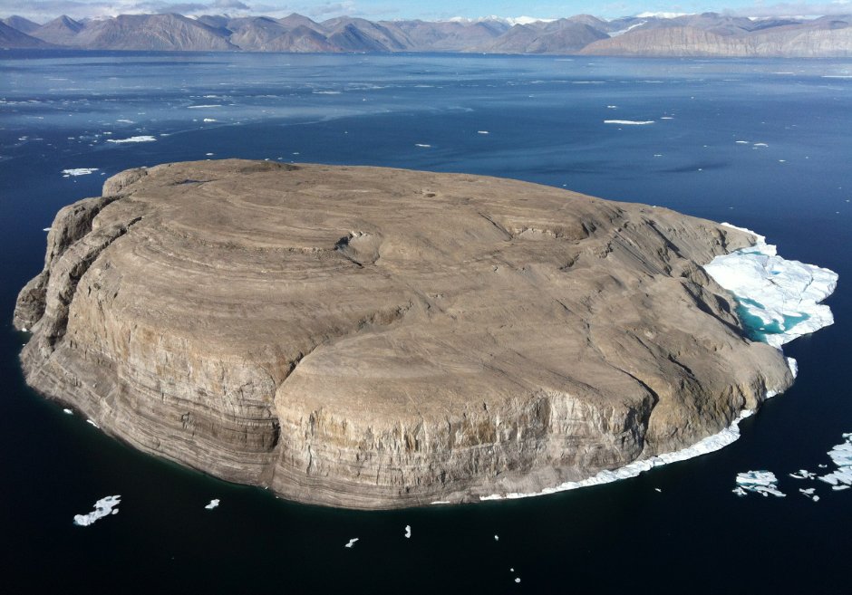
Citing a Source in a Source
Cite both sources.
Hans Island could be designated as an international condominium (Byers, 2010: 29-30 as cited in Nicol and Chater, 2021: 37).
Look up and cite the original source.
Hans Island could be designated as an international condominium (Byers, 2010: 29-30).

Slide 18
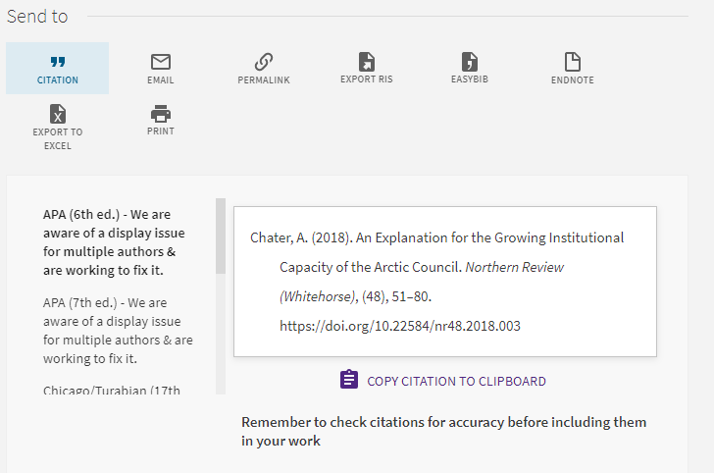
Citation Generators
Sometimes, journal articles include suggested ciations.
There are websites that can create citations for you.
https://www.citationmachine.net/
Omni

Slide 19
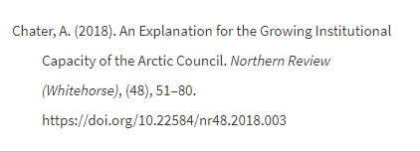
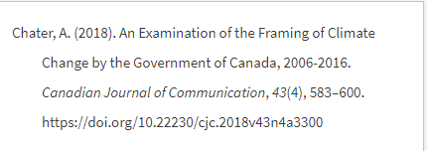
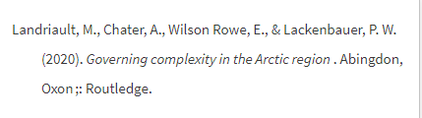
Citation Generators
It is totally okay to use a citation generator; however, you need to check the citations for accuracy and consistency.

Slide 20
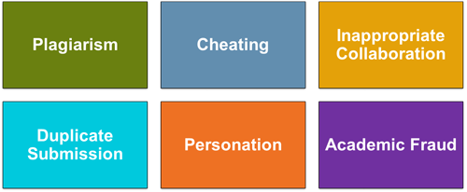
Academic Integrity
Plagiarism: “The practice of taking someone else's work or ideas and passing them off as one's own” (Oxford Dictionary).
Paraphrasing: “Express the meaning of (the writer or speaker or something written or spoken) using different words, especially to achieve greater clarity” (UNT).

Slide 21
Academic Integrity
Least Serious
1 | Copying the words of another with quotation marks but no citation
2 | Copying the words of another with no quotation marks but a citation
3 | Copying the ideas of another with no quotation marks or a citation
4 | Copying the words of another with no quotation marks or citation
5 | Handing in the same assignment multiple times
6 | Buying a paper
Most Serious

Slide 22
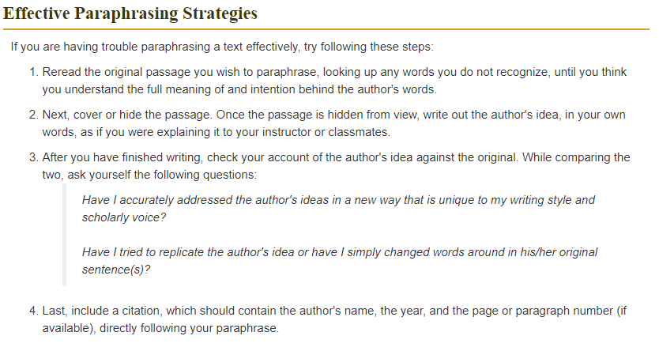
Academic Integrity
https://academicguides.waldenu.edu/writingcenter/evidence/paraphrase/effective

Slide 23

Academic Integrity
Indigenous peoples’ organizations have a unique role of the Arctic Council. They show leadership in the institution. Examples of leadership traits relevant to Indigenous leadership in the Arctic Council are confidence, poise and determination.

Slide 24
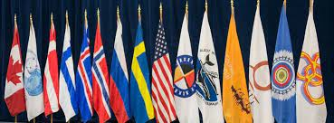
Academic Integrity
All of the Arctic states were in favour of giving a special role to Indigenous peoples when states founded the institution back in 1996, with two exceptions. Policy-makers from Russia and the United States had reservations, fearing that Indigenous peoples’ organizations would use their special status to criticize state policy.

Slide 25
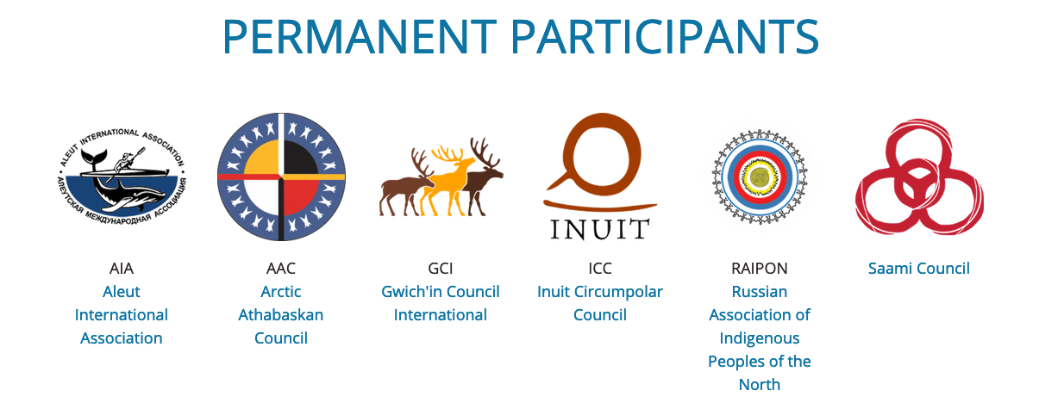
Academic Integrity
Ultimately, states reached a compromise. In keeping with the wishes of most states, Indigenous peoples’ organizations would have a special status in the Arctic Council. To appease Russia and the United States, they would be non-voting members. Today, Indigenous peoples’ organizations are permanent participants in the Arctic Council.

